Slide 1
Analytics Practicum II Project I
Student: Loukopoulos Orestis
ID: f2822104

Slide 2
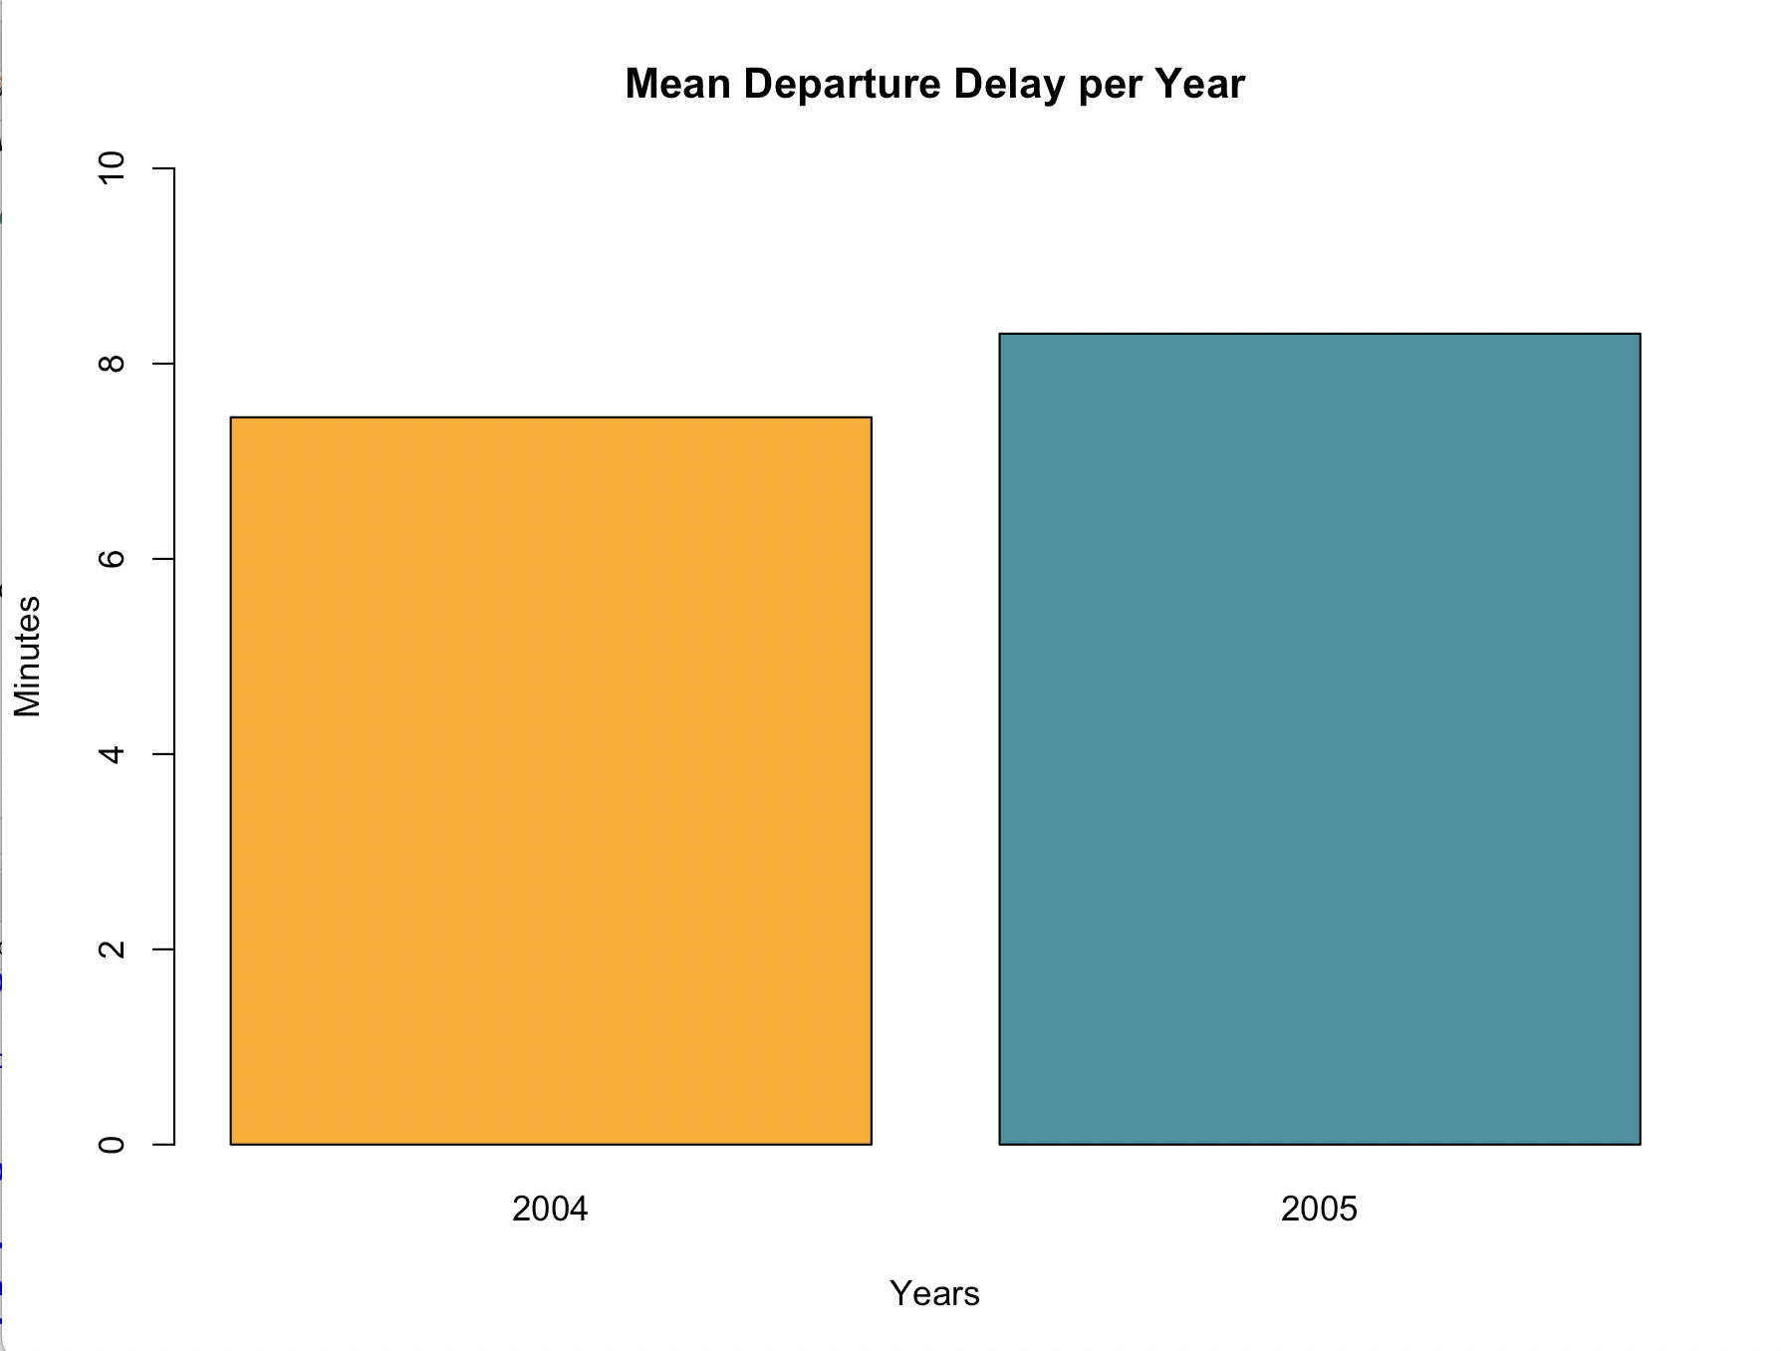
Mean Departure Delay
We can observe that in 2005 the departure delays last on average 45 seconds more than in 2004.

Slide 3
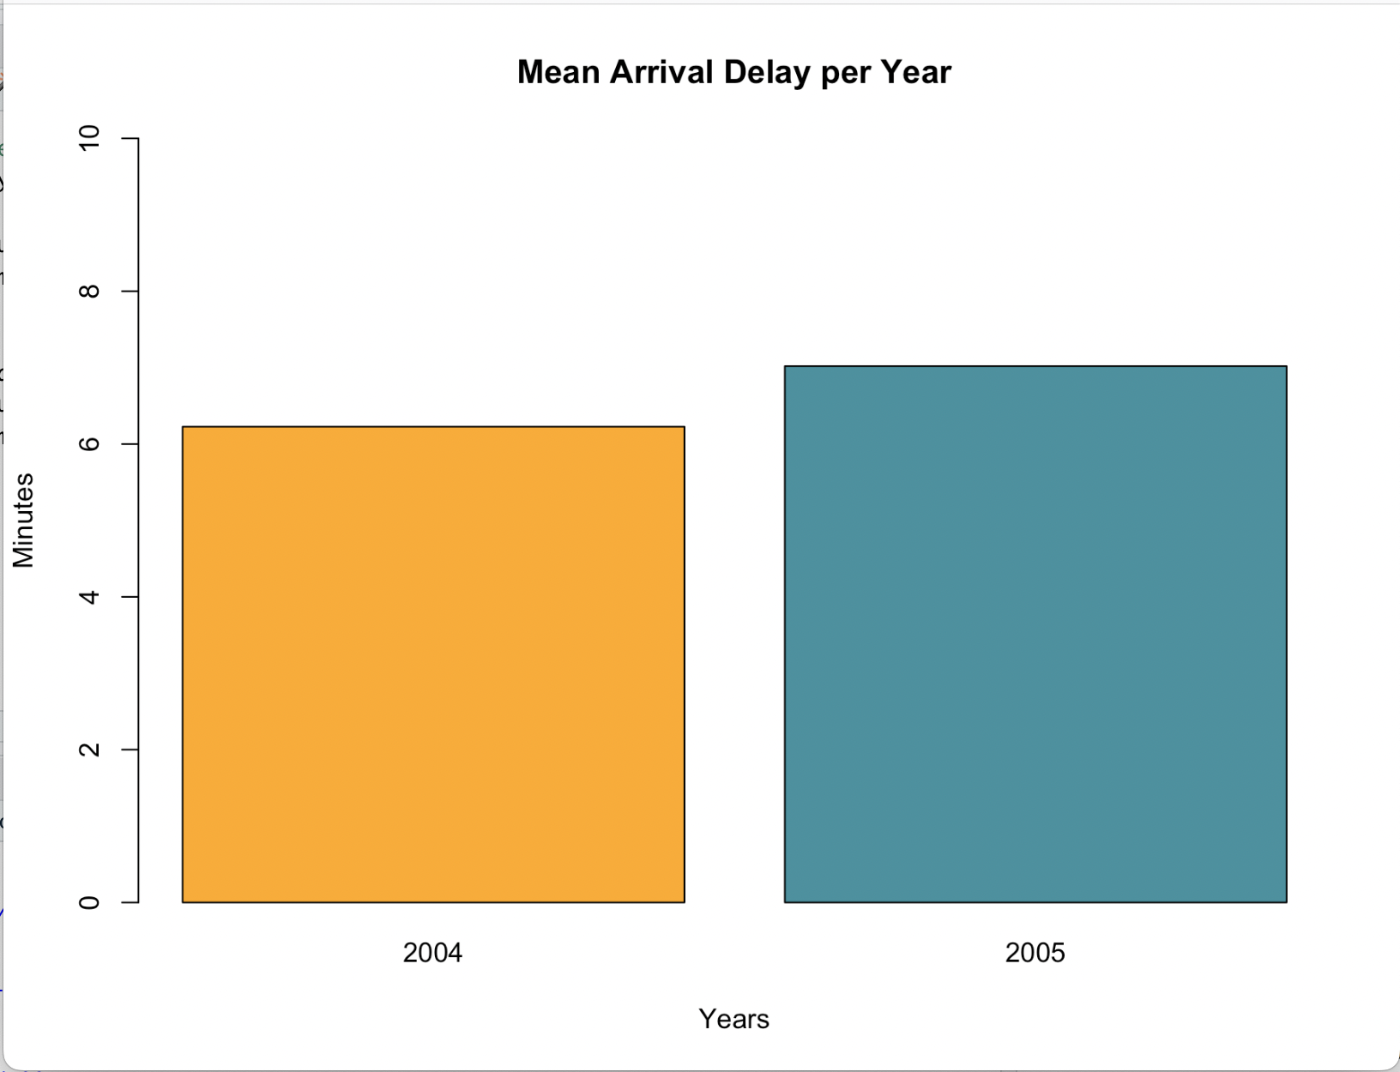
Mean Arrival Delay
We can observe that in 2005 the arrival delays last on average 40 seconds more than in 2004.

Slide 4
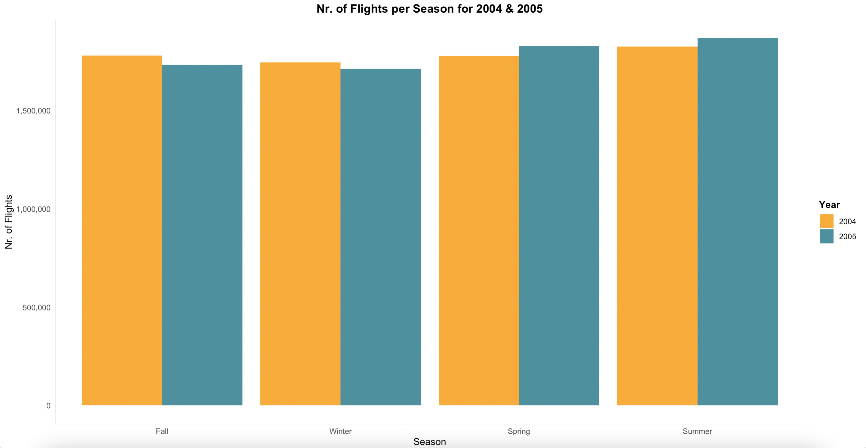
Number of Flights per Season
We can see that there were more flights during Fall and Winter for 2004.
While there were more flights in Spring and Summer for 2005.

Slide 5
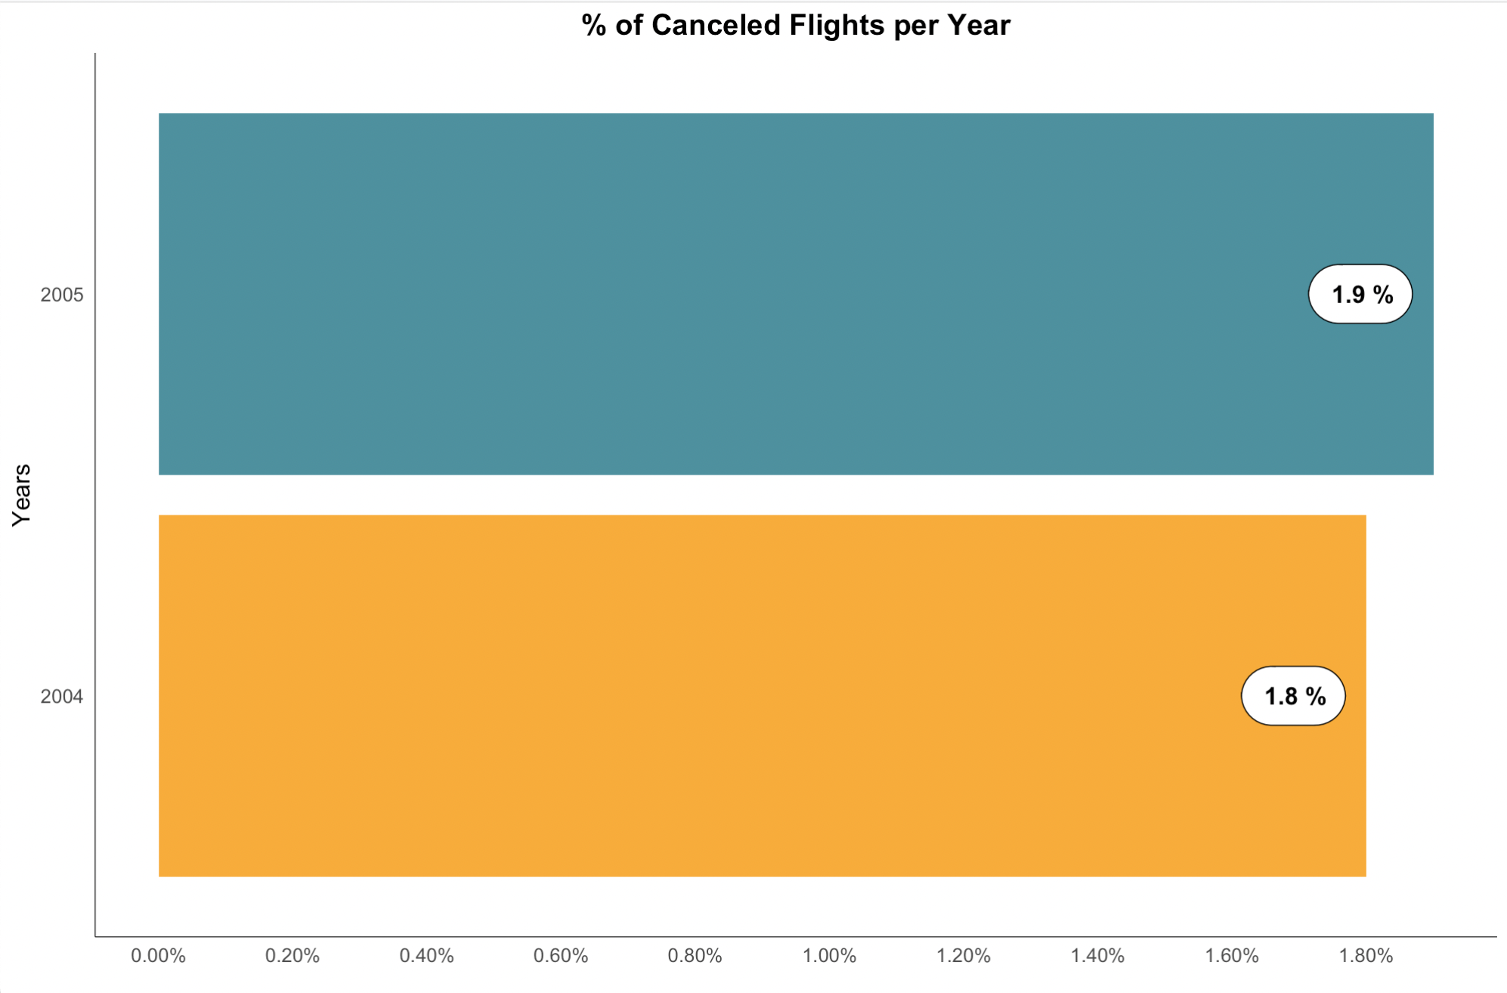

% of Cancelled Flights
A slight increase in flight cancellations can be observed in 2005 compared to 2004.

Slide 6
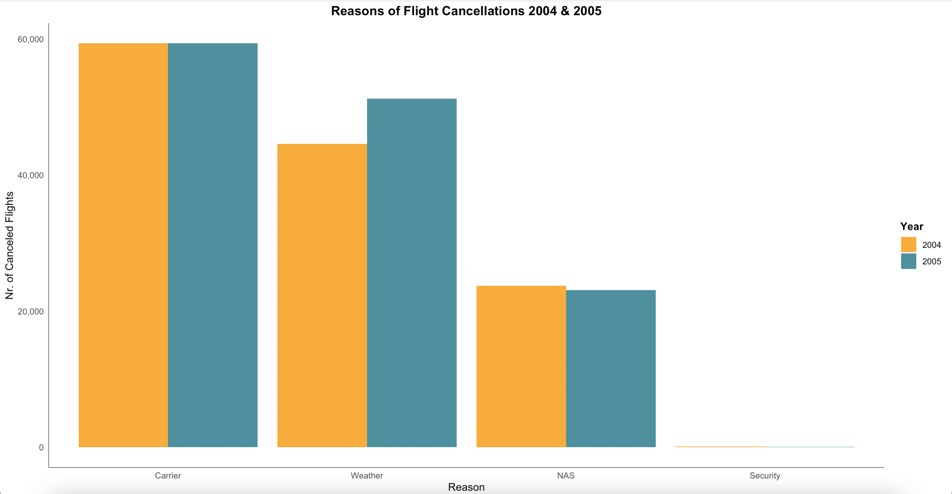
Reasons of Flight Cancellations
We can observe that there is an increase in the number of cancelled flights because of the weather in 2005.
Bad weather conditions may be the reason behind the slight increase in flight cancellations in 2005.

Slide 7
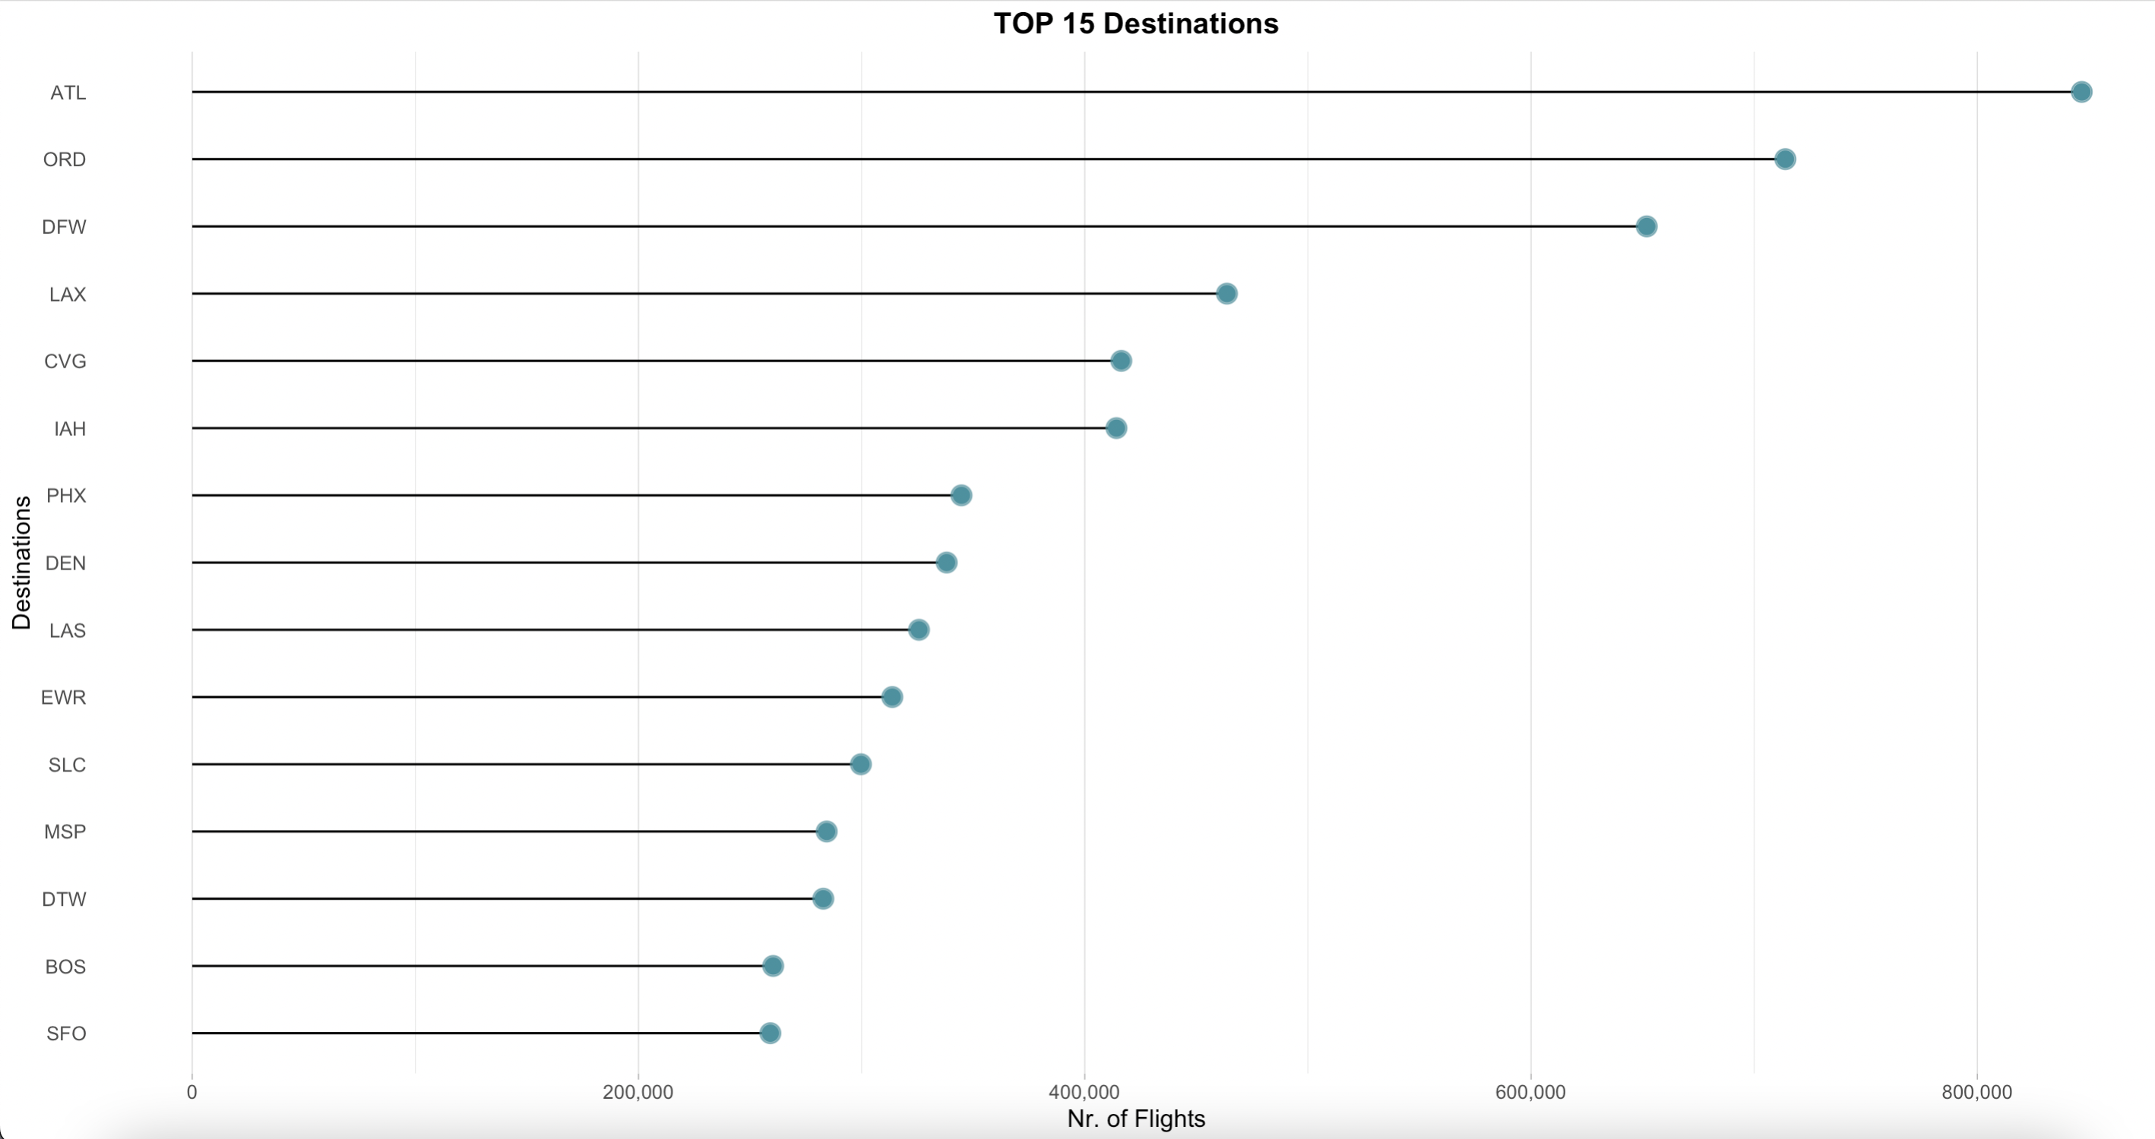
Top 15 Destinations
It can be observed that the airport with the most flights for 2004 & 2005 was that of Atlanta (ATL), with the airports of Chicago (ORD) and Dallas (DFW) following in the second and third place respectively.

Slide 8
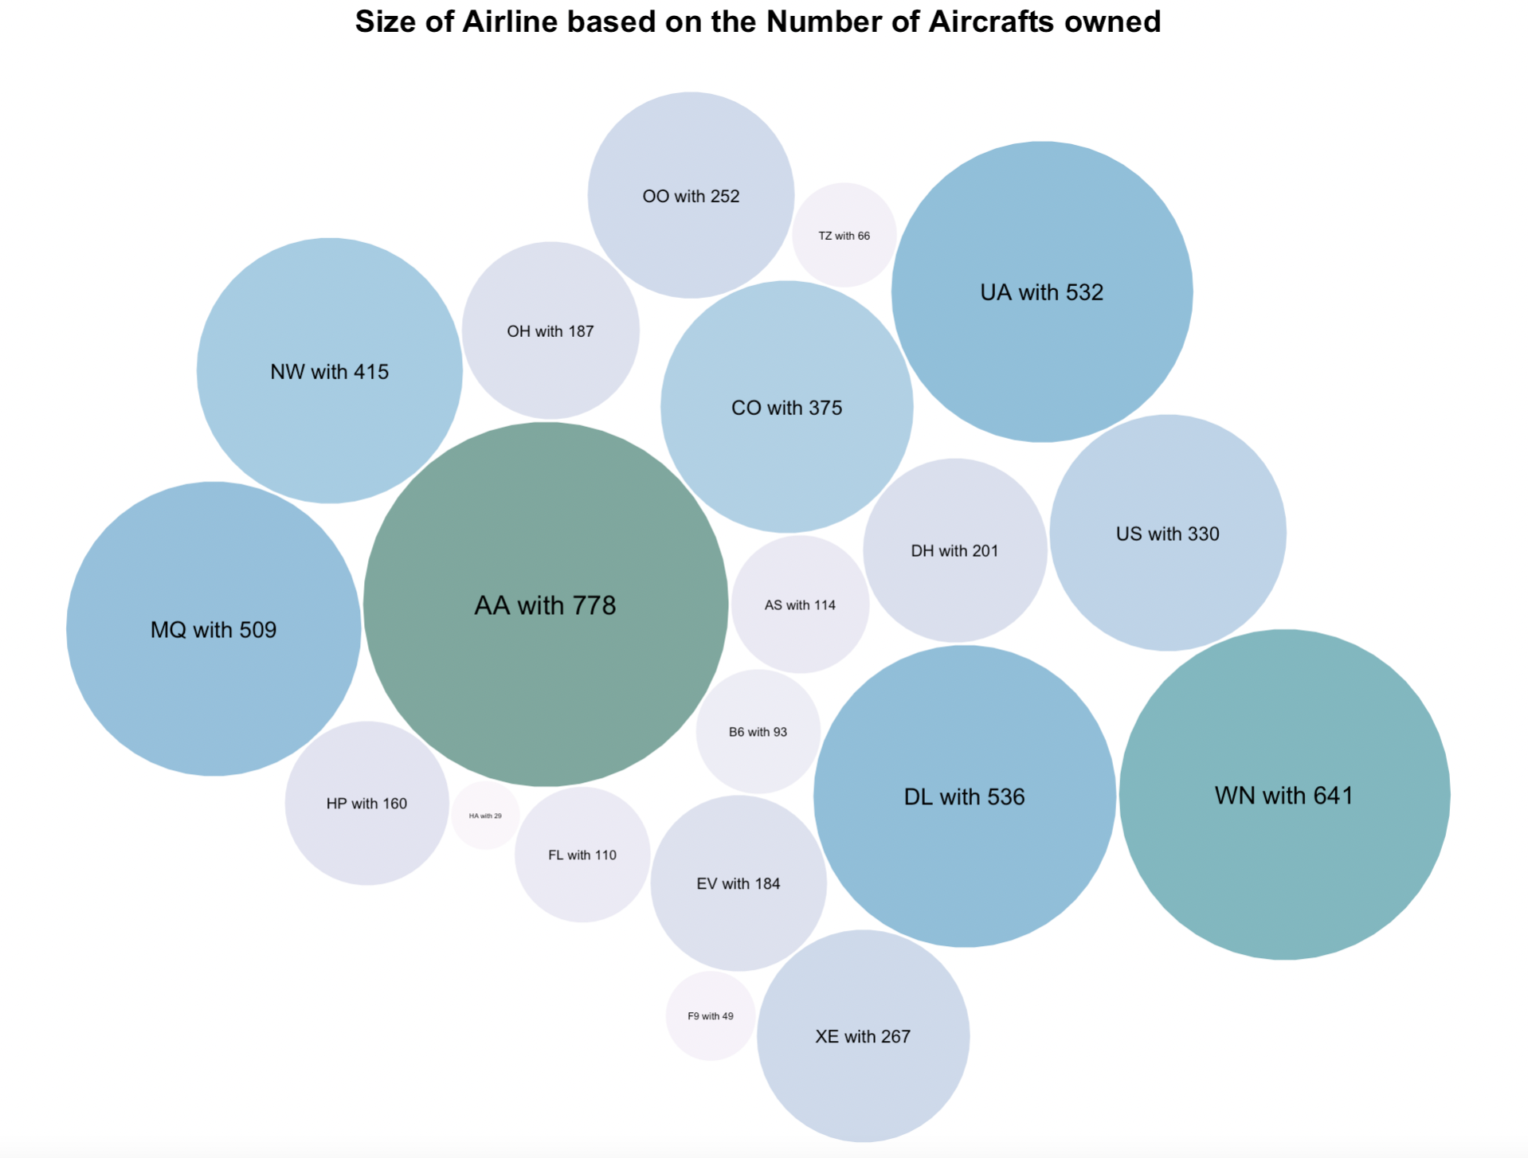
Airlines Size
American Airlines (AA) is the airline with the most aircrafts (specifically 778). The low-cost Southwest Airlines (WN) is next in the ranking (with 641 aircrafts).
The well-known airlines such as Delta (DL) and United (UA) are following in the third and fourth place, respectively.

Slide 9
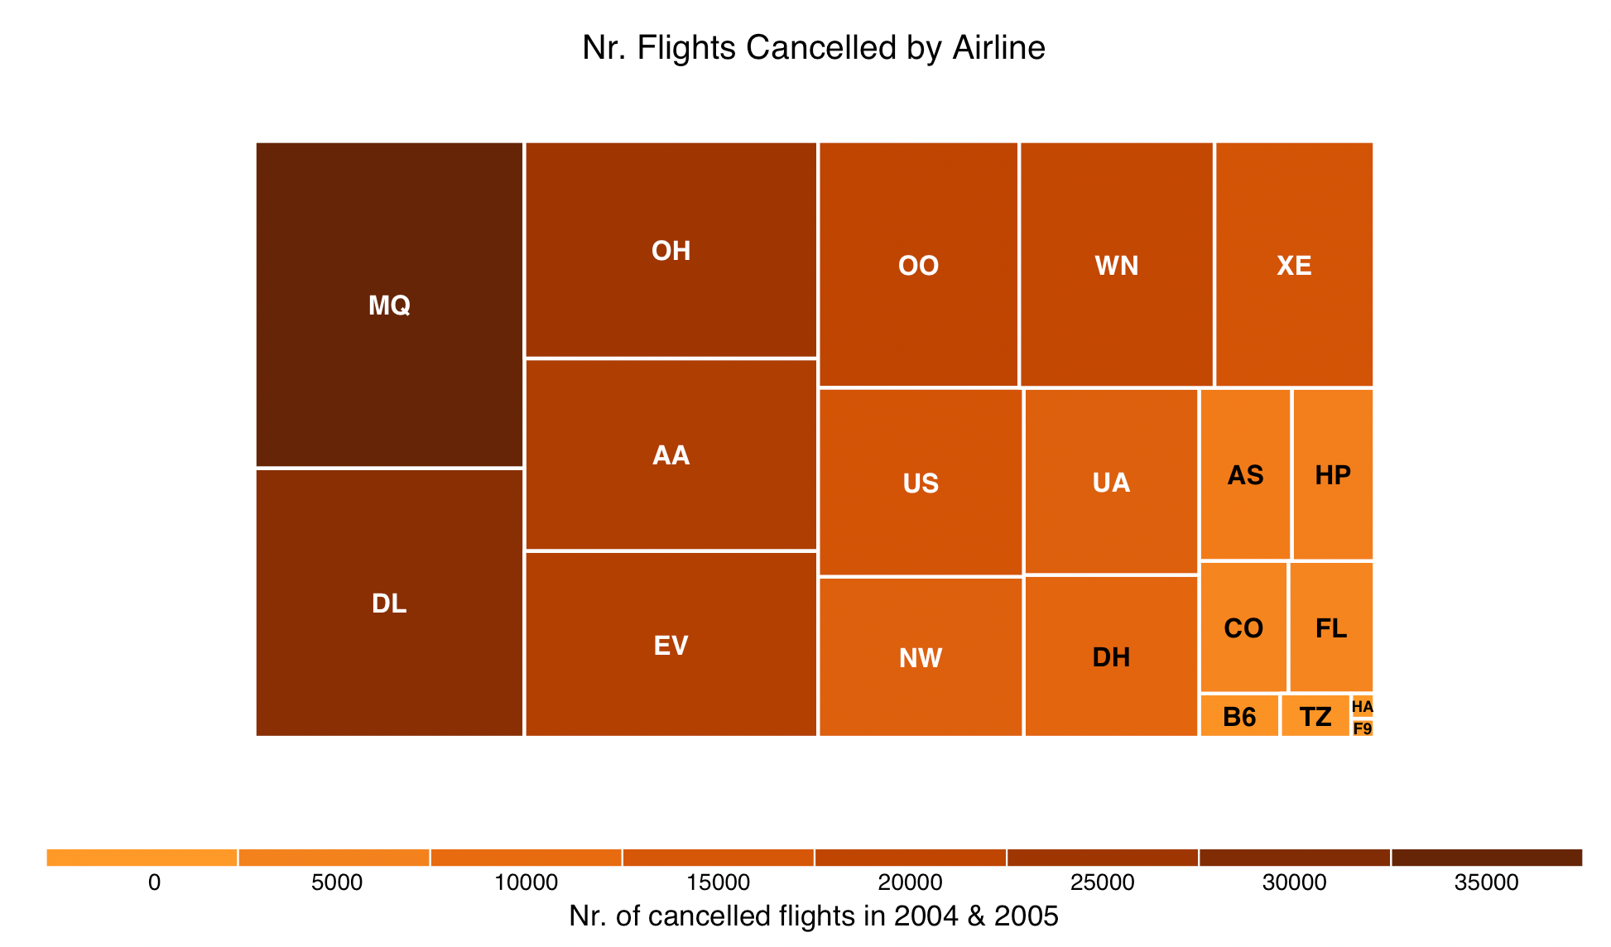
Nr. of Flights Cancelled by Airline
Passengers afraid of a possible cancelled flight should avoid travelling with Envoy Air (MQ) and Delta (DL) as they are the leaders in the number of cancelled flights leaderboard.

Slide 10
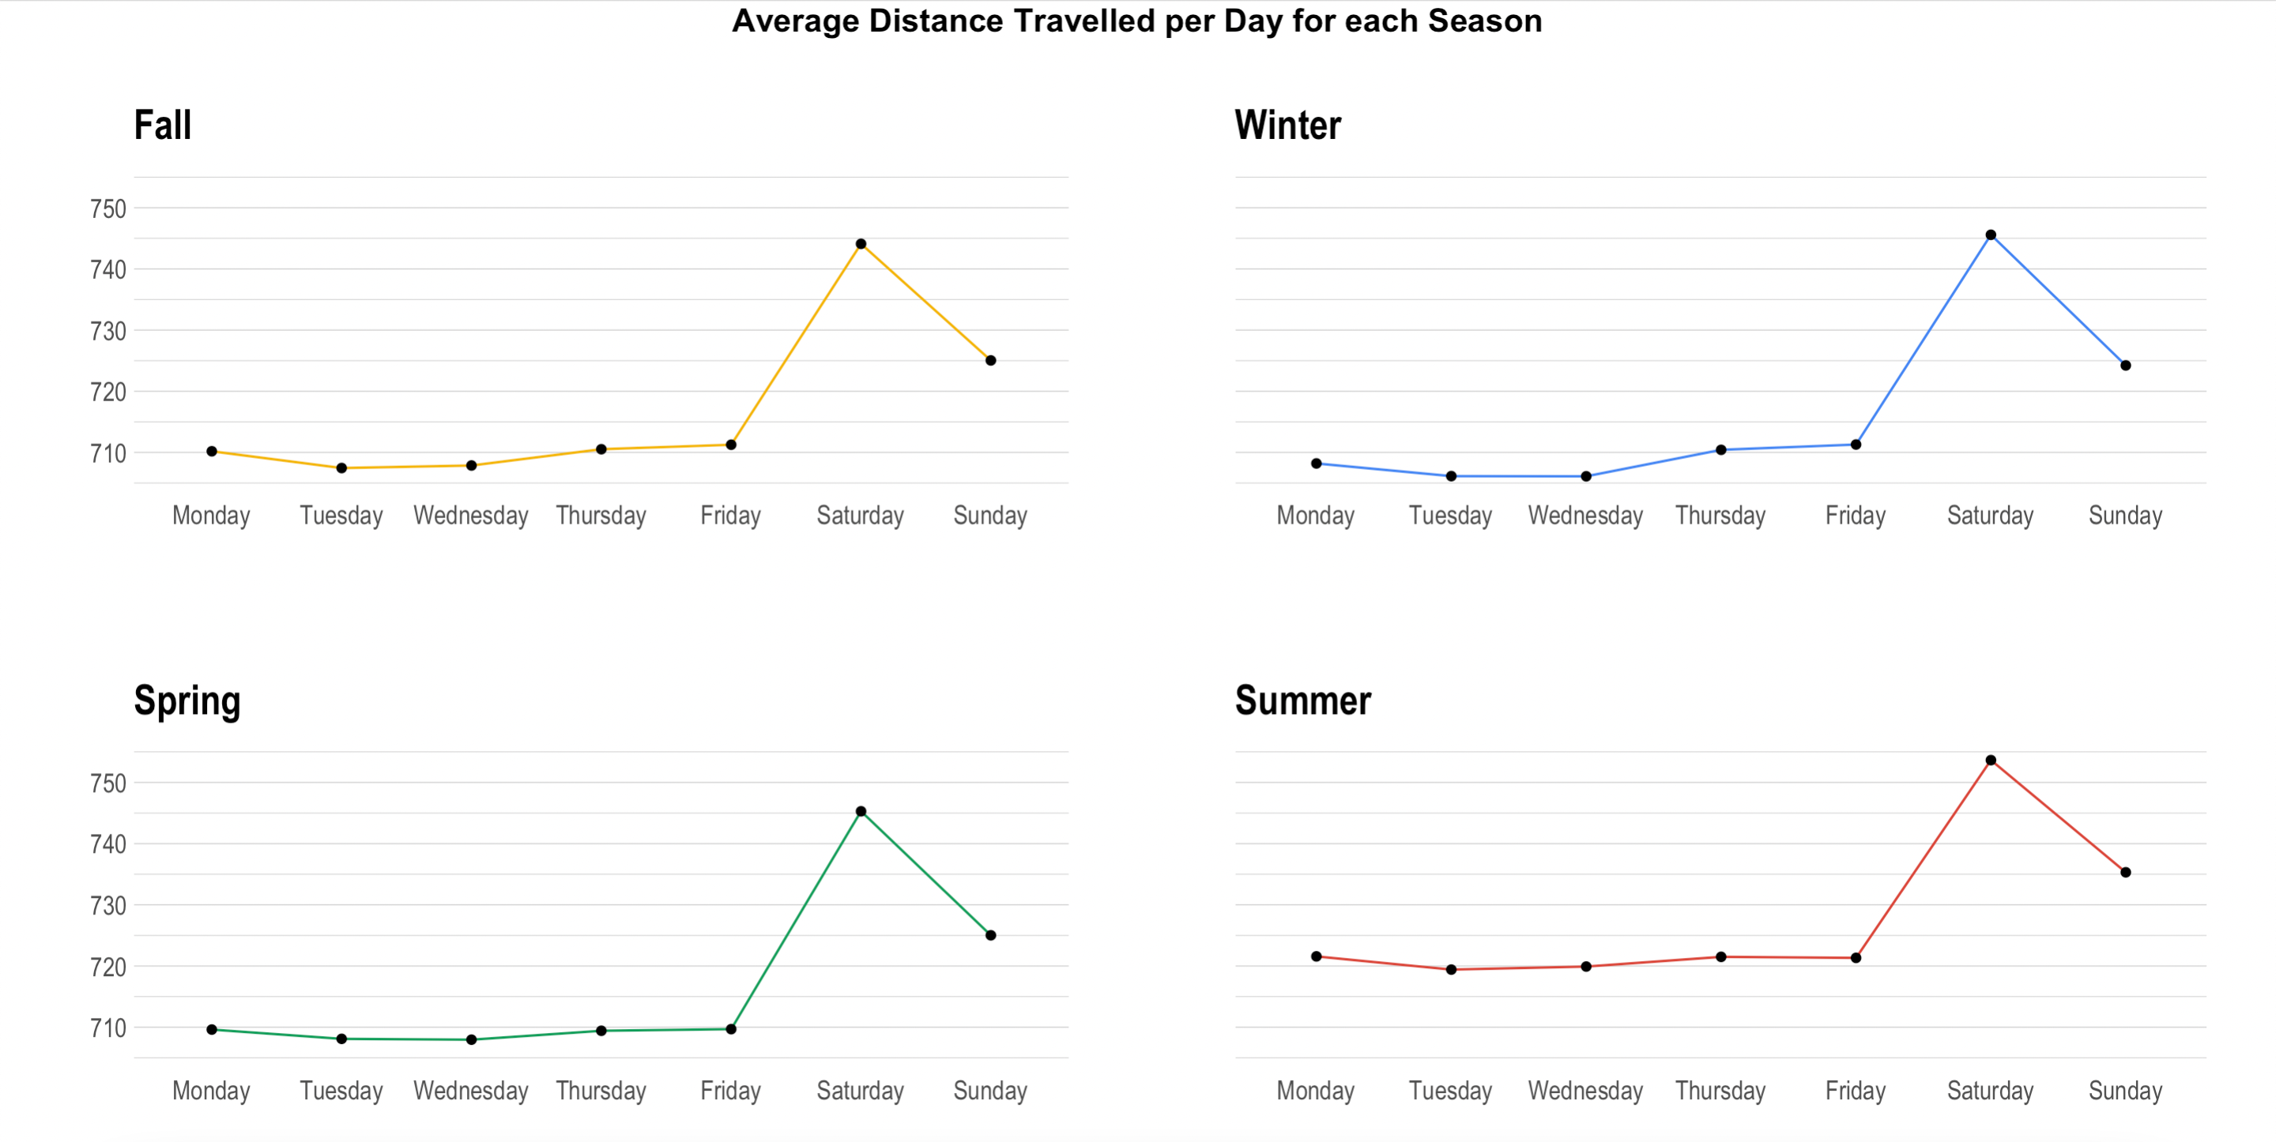
Average Distance Traveled per Day for every Season
It can be observed that for every season, travelers tend to take longer trips on Saturdays. We also observe that there is a noticeable increase in the distance traveled on Summer days.

Slide 11
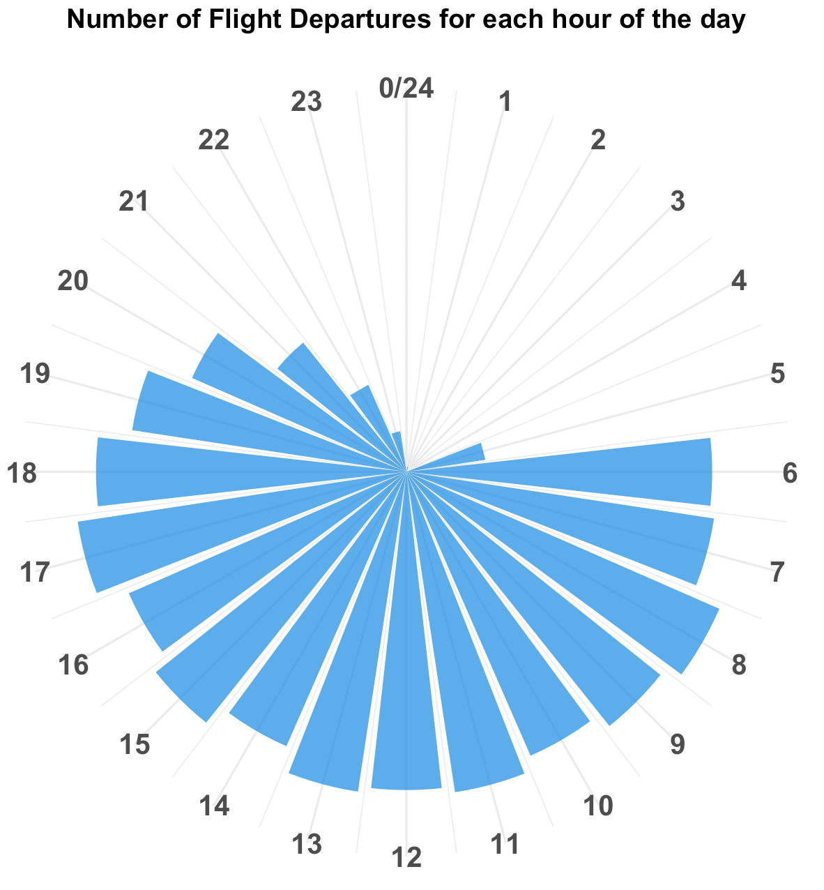
Number of Flight Departures for each hour of the day
It can be observed that most flight departures take place from 8:00 to 17:00 while the number of night flight departures is extremely low.

Slide 12
Thank you!

